Slide 1
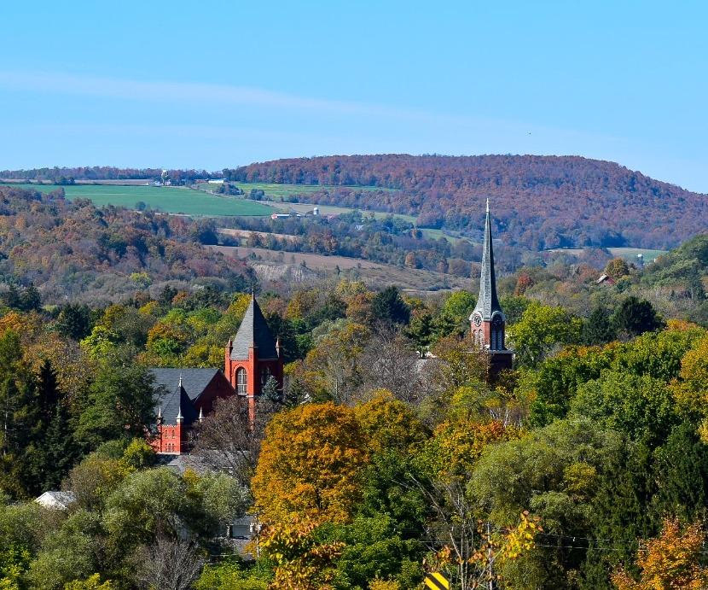
Economic State of Cortland County

Slide 2
IDA/BDC
The BDC and the IDA are the county’s lead economic development agencies working closely with their many local, state, and national partners to retain, create, and attract jobs and to grow Cortland County as a desirable community in which to work, live, and invest.
As an Economic Development Organization (EDO), our goal is to grow the taxable base in the County.
PILOTs
Mortgage Tax, Property Tax, Sales Tax
Grants
Loans
Business Advisement
Site Selection Services
Recruitment/Advertising

Slide 3
Community Health & Economic Development
Family income and where people live is intrinsically linked to health and poverty.
People with few job skills or opportunities often live in neighborhoods where safety is poor, housing is sub-standard, and livable-wage jobs are difficult to find.
Expanding economic development in a community requires education, workforce, businesses, and public sectors at the table
Better jobs are at the heart of community economic development
Better jobs not only support stronger individual health but also provide better individual income and assets (increased tax revenue) to improve homes and neighborhoods.
Community Economic Development = Macro Social Work

Slide 4
Employer/Employee Health Burden
There is a shared health burden between Employees and Employers.
Poor health generates costs for employers, such as health care expenses; higher rates of disability, absences for illness and medical appointments, and people working while sick.
All these create indirect costs that reduce workforce productivity and contribute to declines in labor force participation.
Example: Average full-time worker with diabetes misses an estimated 5.5 workdays per year. Unplanned absences for this disease cost US employers $20 billion annually.
Indirect costs of diabetes to employers may approach $90 billion per year.

Slide 5
Cortland County Economic Stats
2021 Population was ~47,000 with a median age of 36.5
Median income is around $65,029
Largest industries are educational services, health care, and accommodation/Food service.
There were 980 total employer establishments in 2021
13,269 total employment in 2021 which was down by 11.9% from 2020.

Slide 6
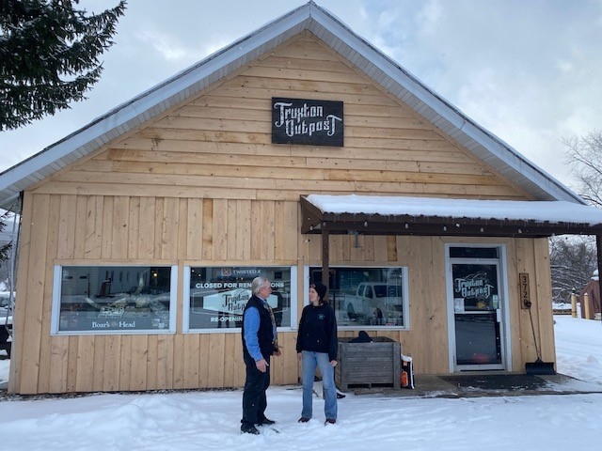
Business Assistance for Covid Recovery
BDC awarded $600,000 in CC ARPA Funds in 2022
Three separate grant programs; Main Street, Façade & Streetscape, and Small Biz Expansion Program
Main Street provided five, $5000 grants to assist start-up businesses on Main Street
Façade and Streetscape awarded $266,000 to 36 businesses to create a total return on investment of $522,000
Expansion program saw nearly $303,000 awarded to 38 businesses with a total return on investment of $560,000
$600,000 in County ARPA funds leveraged $1.1 million in economic activity in Cortland County
20 MWBE businesses, 5 AG

Slide 7
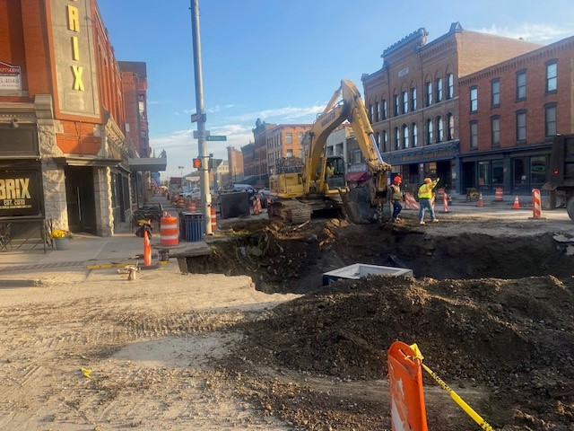
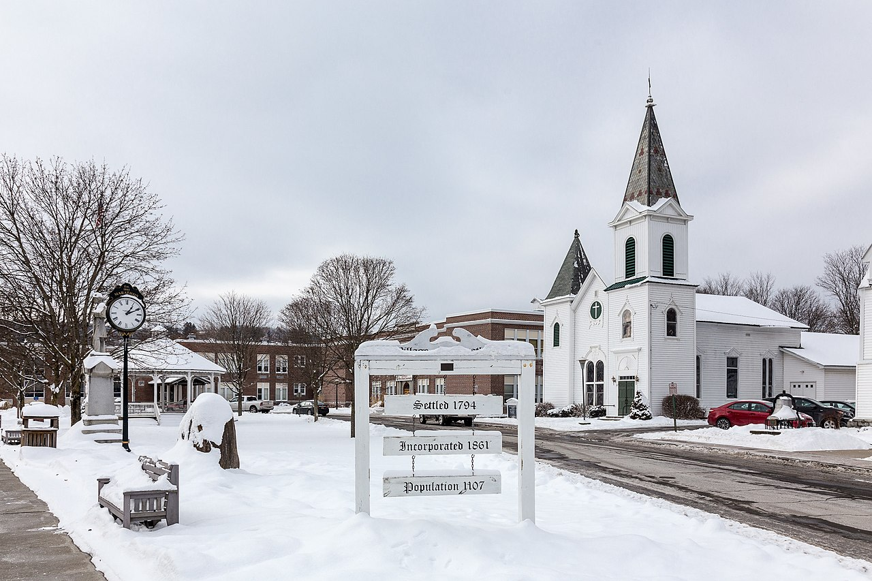
DRI & NY Forward
Cortland
Homer
Marathon

Slide 8
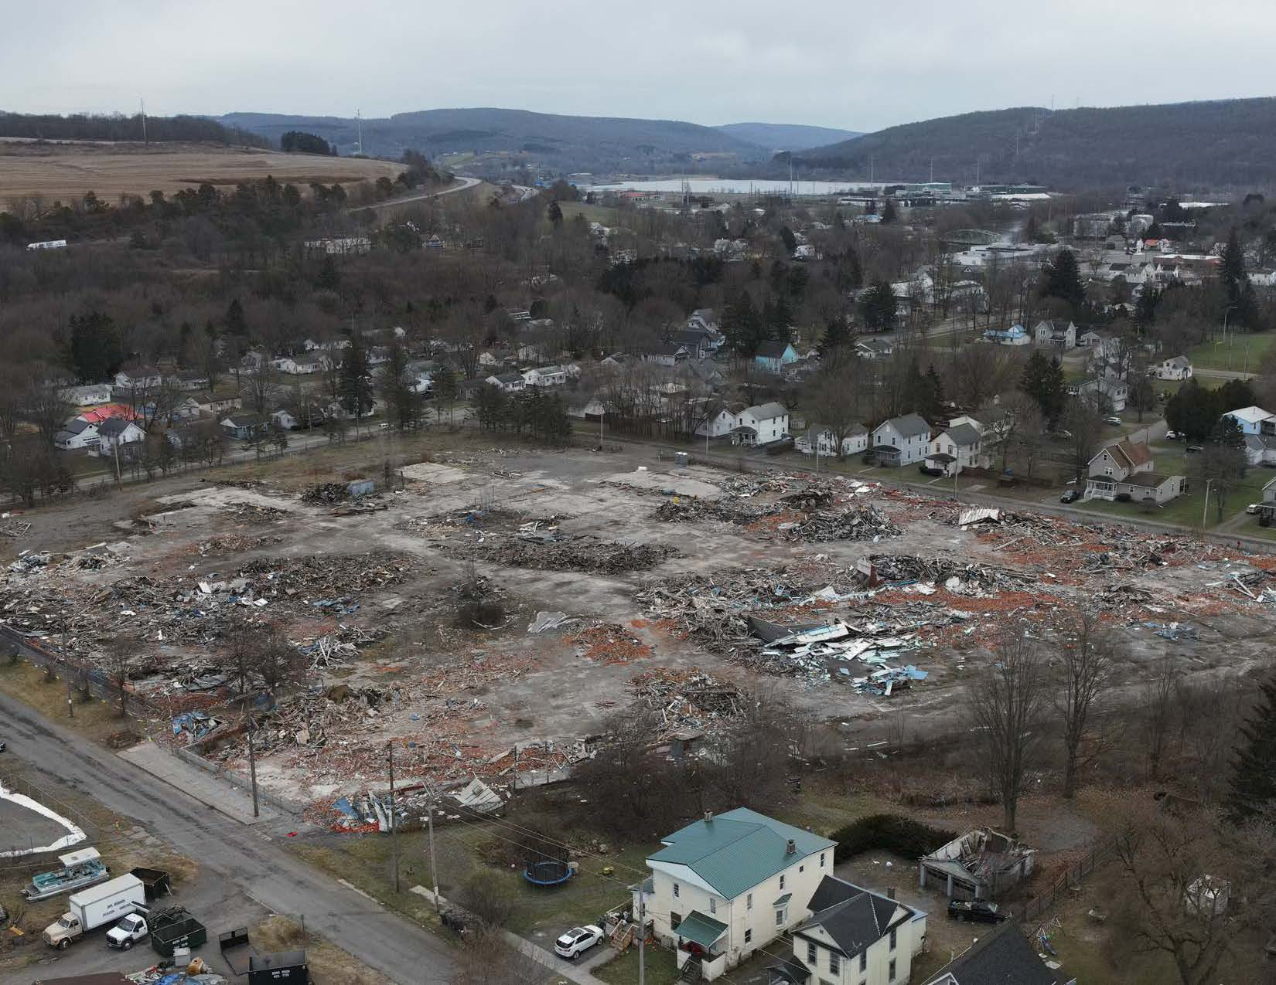
Apex
Cleanup
Phase I & II
EPA Grant

Slide 9
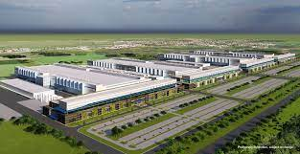
Micron
Task Force
Potential Funds available
Engage Locals

Slide 10
iSpice
Former Voyent site
Site Marketing provided by IDA/BDC
$25,200,000 project
$2.5M in new taxes over the next 10 years
350 new jobs over the next 3 years
Year 1 – 175 FTE
Year 2 – 125 FTE
Year 3 - 50 FTE

Slide 11
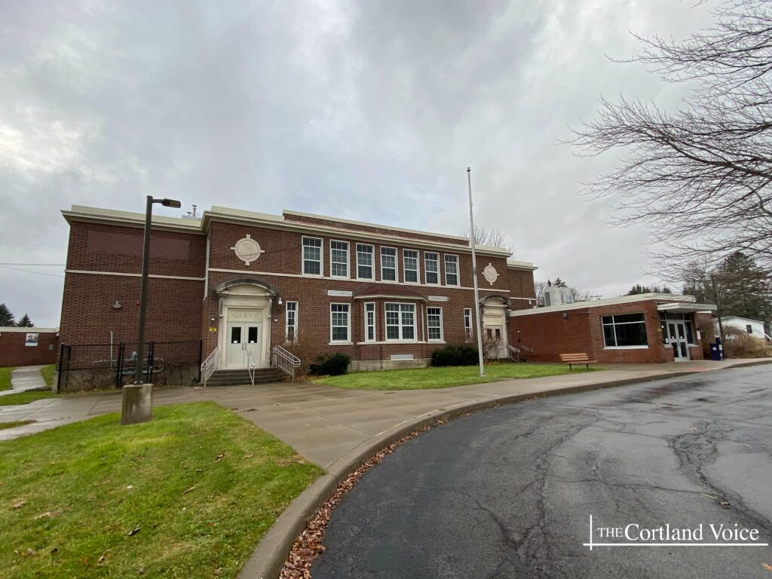
Kajen LLC – Virgil School
Former Virgil Elementary School
$2.4M project
$200,643 in new taxes
Creates 19 one and two-bedroom apartments for residents 55 and older
Will maintain the facility as a community gathering spot and a town emergency evacuation site
Grounds will continue to host community events
Outside of the building will remain relatively intact

Slide 12
IDA Projects in 2023
12 ongoing projects
388 Jobs created
Housing, Industrial, Agriculture, and Renewable Energy

Slide 13
BDC Small Business Consulting
Core Services
Staff & SBDC
Case-by-case

Slide 14
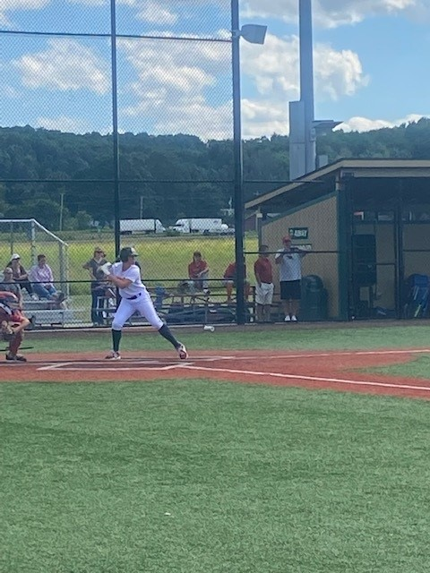
Sports Tourism
Gutchess Lumber Sports Park
Cortland Regional Sports Council

Slide 15
New Frontiers
Continue to engage with solar and renewable energy developers

Slide 16
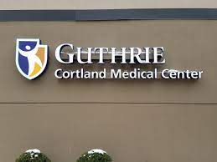
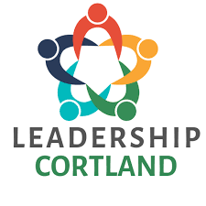
Community Partners

Slide 17
Thank you!
Brendan O’Bryan – Executive Director
P: 607.756.5005
E: Brendan@cortlandbusiness.com

