Slide 2
Perinatal Health in
Cortland County
Mary Carney
Kate Downes

Slide 3
Mary Carney
Mary Carney Consulting
marycarneyconsulting.com​

Slide 4
What is perinatal health? ​
Health of pregnant people and babies​
during pregnancy
through childbirth​
during the postnatal period and
through the first year​

Slide 5
In Cortland County...
About 460 live births per year​
51% of births are covered by Medicaid or Family Health Plus
52% of births are to unmarried parents
Source: NYS Vital Statistics, https://www.health.ny.gov/statistics/vital_statistics/2020

Slide 6
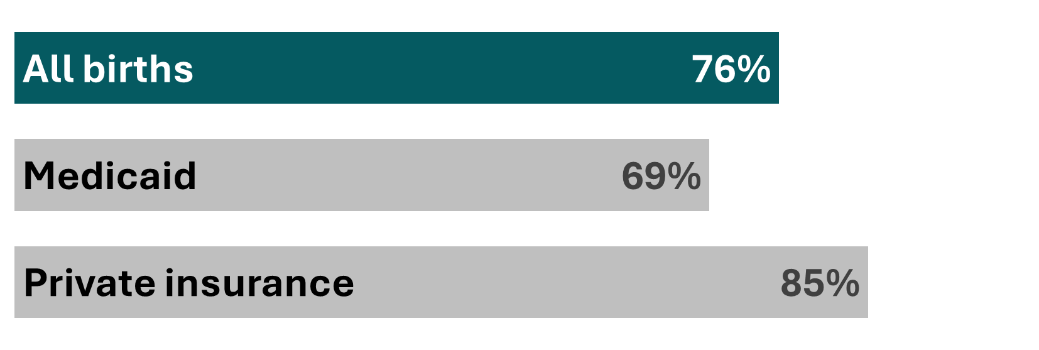
Not everyone gets early prenatal care​.
About 3 in 4 pregnant people in Cortland County get prenatal care during the first trimester ​
Source: Statewide Perinatal Data System, 2022

Slide 7
Substance use during pregnancy is a problem.
Cortland County has the 3rd highest rate in NY State for drug-dependent babies (2020)​
13% smoke during pregnancy (2022)​
Rates are higher among those with Medicaid (21%)
Source: SPARCS as of August 2022, https://apps.health.ny.gov/public/tabvis/PHIG_Public/mch/reports/#county;
Statewide Perinatal Data System, 2022

Slide 8
Other challenges
Few providers
Few programs
Transportation
Isolation

Slide 9
Kate Downes
Seven Valleys Health Coalition
sevenvalleyshealth.org

Slide 10
What is a doula? ​
“A trained professional who provides continuous non-judgemental physical, emotional, and informational support to a pregnant person before, during, and shortly after childbirth to help them achieve the healthiest, most satisfying experience possible.”
-DONA International

Slide 11
Types of Doulas​:
Fertility​
Birth​
Postpartum​
Death​
Bereavement​
Indigenous

Slide 12
The Doula Partnership
Started in Cayuga County, with Cayuga Community Health​
Seven Valleys Health Coalition and Madison County Rural Health Council joined in 2022​
Herkimer County Public Health joined in 2023

Slide 13
The Doula Partnership:
Cortland County
Cortland County​
16 birth doulas active in The Doula Partnership​
5 births in 2023​
Accept self-referrals​
Referrals from medical providers, organizations, county agencies

Slide 14
Doula, Midwife, or OB/GYN?
Doula
Certified, non-medical birth coach ​
Does not provide medical care, give medical advice, or make medical decisions for the pregnant person
Provides continuous support and encouragement
Helps educate and empower the pregnant person​

Slide 15
Doula, Midwife, or OB/GYN?
Midwife
Medically trained professional (Certified Nurse Midwife or Certified Midwife)​
Provides medical care: monitoring vital signs, performing vaginal exams, and delivering the child. ​
Can deliver babies in a hospital, birth center, or support a home birth.​
Encourages minimizing unnecessary medical interventions
OB/GYN (obstetrician gynecologist)
Medical doctor that specializes in women's health, reproductive health, pregnancy, and childbirth
Manages high risk pregnancies and any complications that arise during delivery​
Delivers babies in a hospital​
Can perform c-sections and other advance surgeries

Slide 16
What services does the Doula Partnership provide?​
Three prenatal visits ​
Advocacy and support throughout labor and birth (up to 12 hours)​
Three postpartum visits ​
No cost to the pregnant person​
Shares education and resources​
Meets each person with non-judgement

Slide 17
Why work with a doula?​
Evidence-based supports​
Can shorten labor by 41 minutes on average​
Increase the likelihood of spontaneous vaginal birth by 15%​
Decrease risk for Cesarean birth by 39%​
Decrease the use of pain relief medications by 10%​
Decrease the baby's risk of a low 5-minute APGAR score by 38%​
Increases the likelihood of a positive birth experience in a hospital setting by 69%
Source: 2017 Report, Department of Reproductive Health and Research, World Health Organization

Slide 18
"Doulas offer one of the most effective tools to improve labor and delivery outcomes."
​
-American Congress of Obstetrics & Gynecologists
and the Society for Maternal-Fetal Medicine​
because
everyone
deserves
a birth
-The Doula Partnership

Slide 19
Connect with us!
Mary Carney
Mary Carney Consulting
marycarneyconsulting.com
marycarneyconsulting@gmail.com​
Kate Downes
Seven Valleys Health Coalition
sevenvalleyshealth.org
kate@sevenvalleyshealth.org
sevenvalleyshealth.org/doula

