Slide 1
CORTLAND COUNTY YOUTH SURVEY

Slide 2
What is happening?
Substance Use
Indicators
Mental Health
Indicators
Health Disparities
Mental= health indicators all decreased from 2022 and show general decrease over time.
Most youth did not talk to anyone about their mental health challenges.
All substance use has been on a decline from 2019-2023, with the lowest rates of use for all substances in 2023.
Younger students are less likely to report using any substances.
Youth identifying as BIPOC, Female, LGBQ+, transgender, having a disability, or residing in urban areas report higher substance use and mental health challenges.

Slide 3
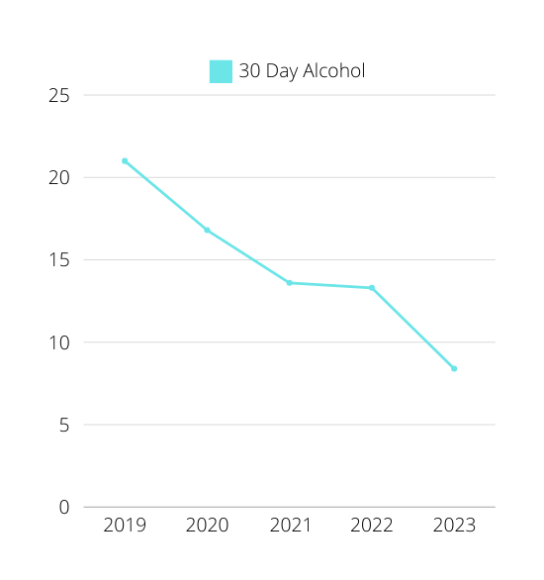
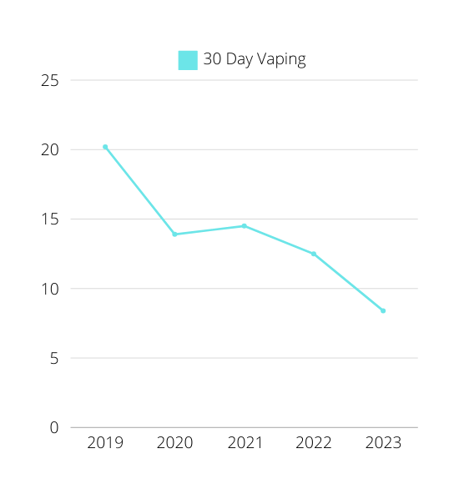
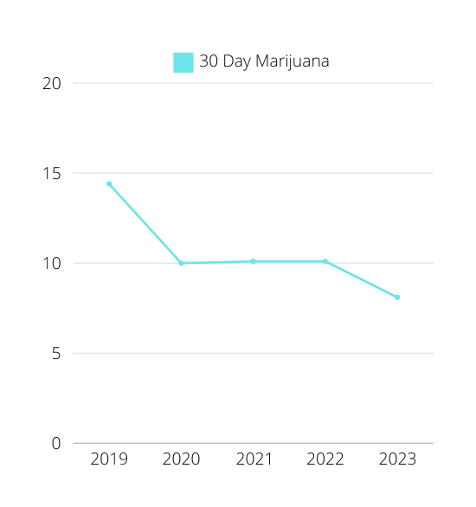
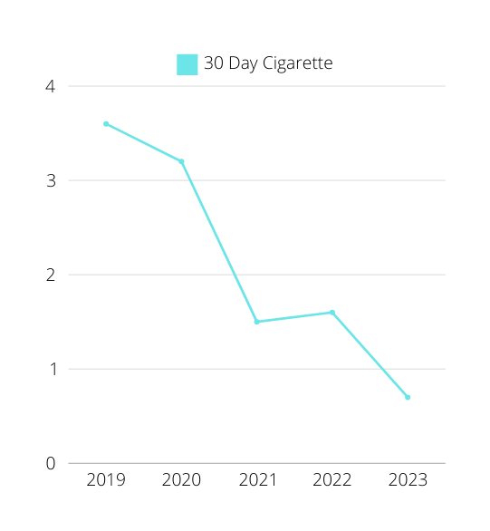
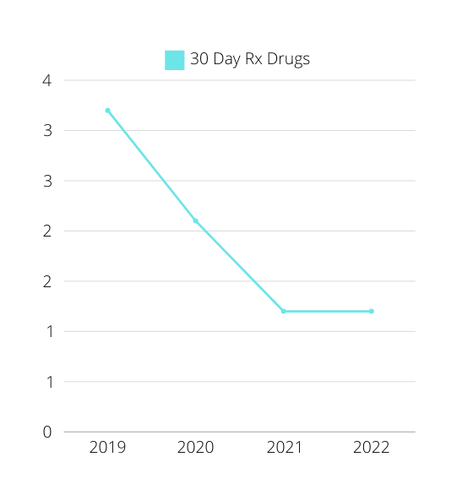

Slide 4
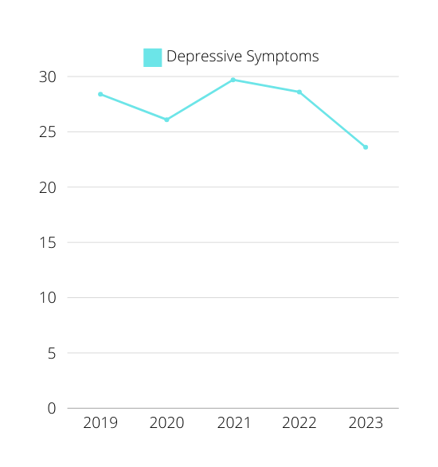
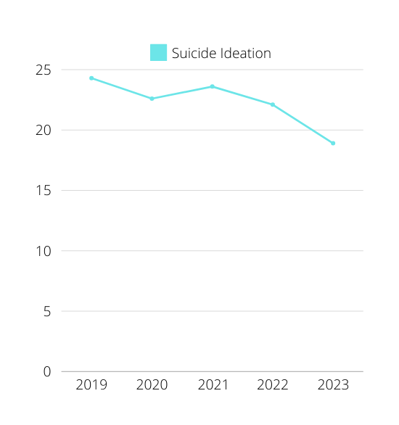
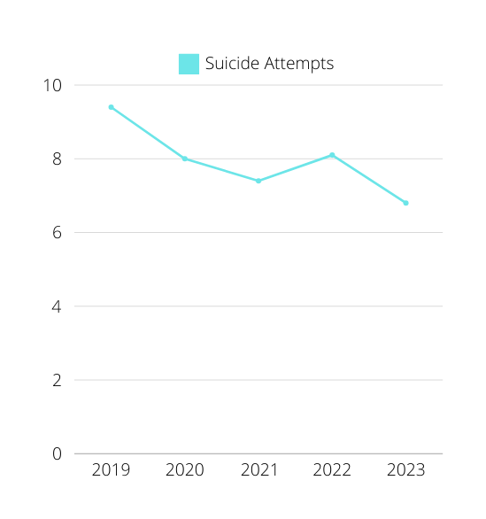

Slide 5
The NEW Youth Survey
Starting with the 2023-2024 school year, we are using a new survey that included
questions about other health factors like
Sleep
Social Media Use
Nutrition
Disabilities
Physical Activity
Gun Access
Social Connections
Mental Health Support

