Slide 1
Lessons Learned:
the HEALing Communities Study
& future of overdose death
prevention work
Sara Watrous, Project Director
Aster Parrott, Community Engagement
Coordinator
Rural Health Institute of New York (RHI)
Notes:
Sara
Alternate title: Lessons Learned from the HCS / Lessons Learned from our county-wide overdose death prevention initiative
Opioid Task Force
Looking Back and
Looking Forward

Slide 2
Cortland County - 1 of 67 communities participating in the HEALing Communities Study (HCS)
NIH-funded research study and implementation grant (2020-2024) with the goal of reducing opioid-overdose deaths by 40% across all communities
Cortland County contracted with RHI (then CACTC) to manage the project
A team of 3 full-time staff
Around $500,000 to implement evidence-based strategies to reduce overdose deaths
Notes:
Sara

Slide 3
As part of HCS, Cortland created the Opioid Task Force (OTF) in summer 2022
The Healing Cortland Team established and facilitated the OTF to
Engage a diverse group of stakeholders, including people with lived experience
Use local data to select strategies shown to reduce overdose deaths, allocate resources and monitor implementation
Conduct 3 communications campaigns to raise awareness and reduce stigma
Notes:
Aster
Over 80 Opioid Task Force members
Almost 50 workgroup members from over 19 agencies/ organizations
Over 250 person-hours from workgroup members (not just CACTC team)

Slide 4
Project Timeline
Notes:
Aster
https://www.canva.com/folder/FAEQm21wVyE

Slide 5
Strategies and Goals
Notes:
Aster

Slide 6
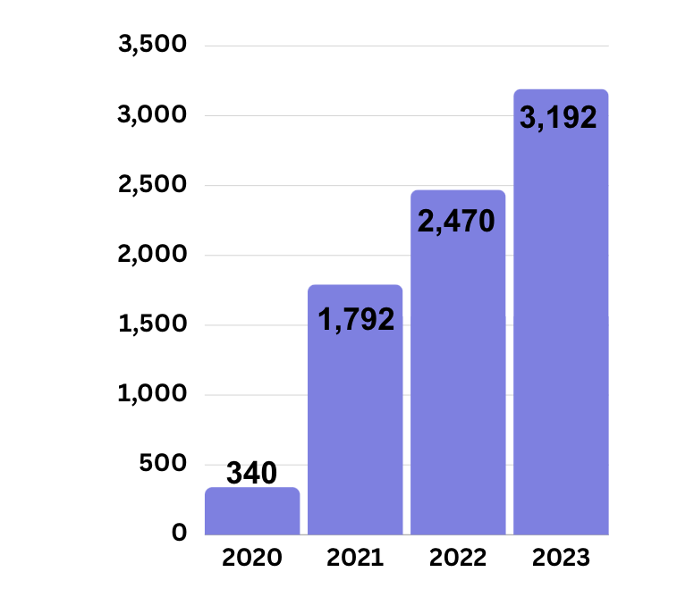
Narcan: Over 3,000 kits distributed in 2023!
July 2020 Naloxone Distribution
Workgroup was created
Notes:
Sara
Narcan Timeline: https://healingcortland.org/narcan/history-of-cortland-county-naloxone-distribution

Slide 7
Narcan: What did we learn?
Data is important for measuring impact and knowing when to make changes
Partnerships are important, need to continue breaking down silos
People with lived experience are largely unutilized asset
One size doesn’t fit all, trainings must be tailored
Staffing isn’t the determining factor we thought it was
Notes:
Sara

Slide 8
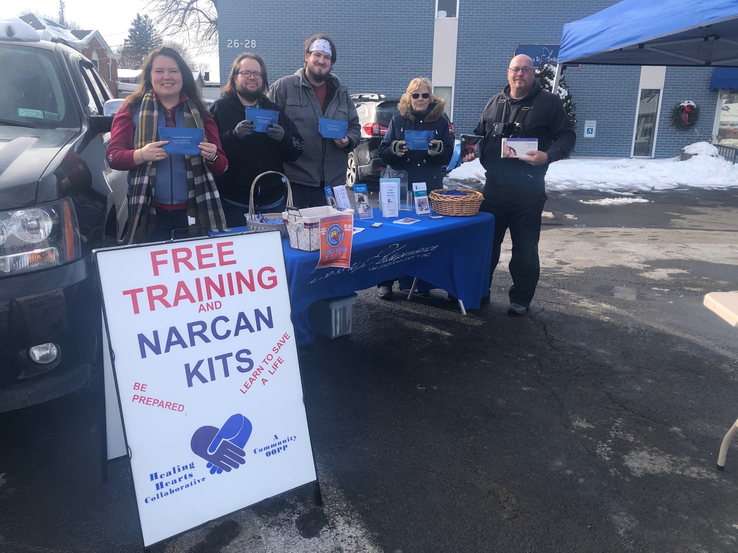
One size of training doesn’t fit every need
Trying to lower barriers to Narcan access
Hour long trainings → quick trainings
Passive distribution
But there’s still a role for longer trainings
Providing education on proper response, harm reduction
Reducing stigma
Notes:
Sara

Slide 9
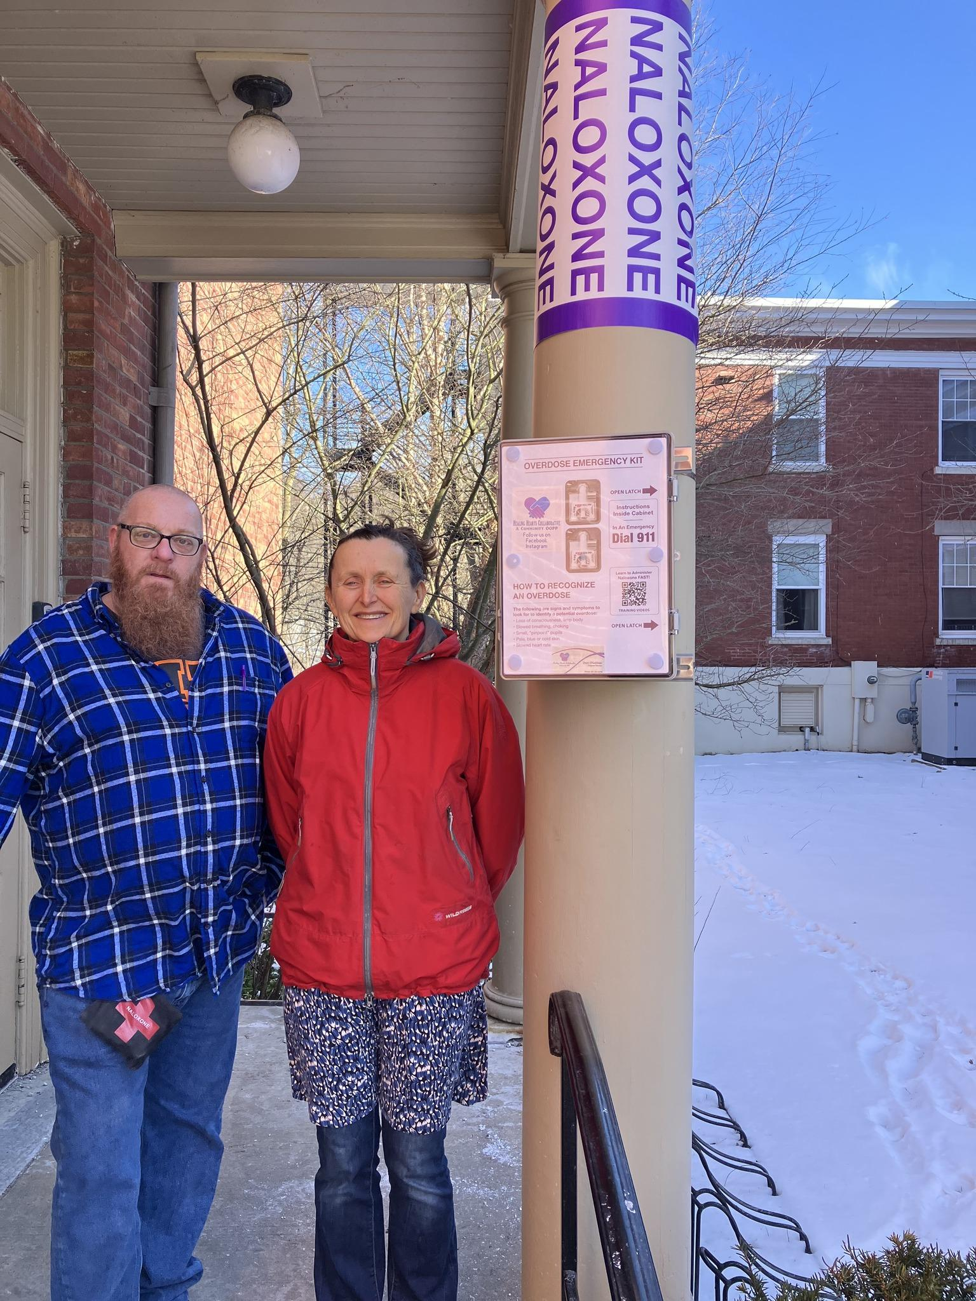
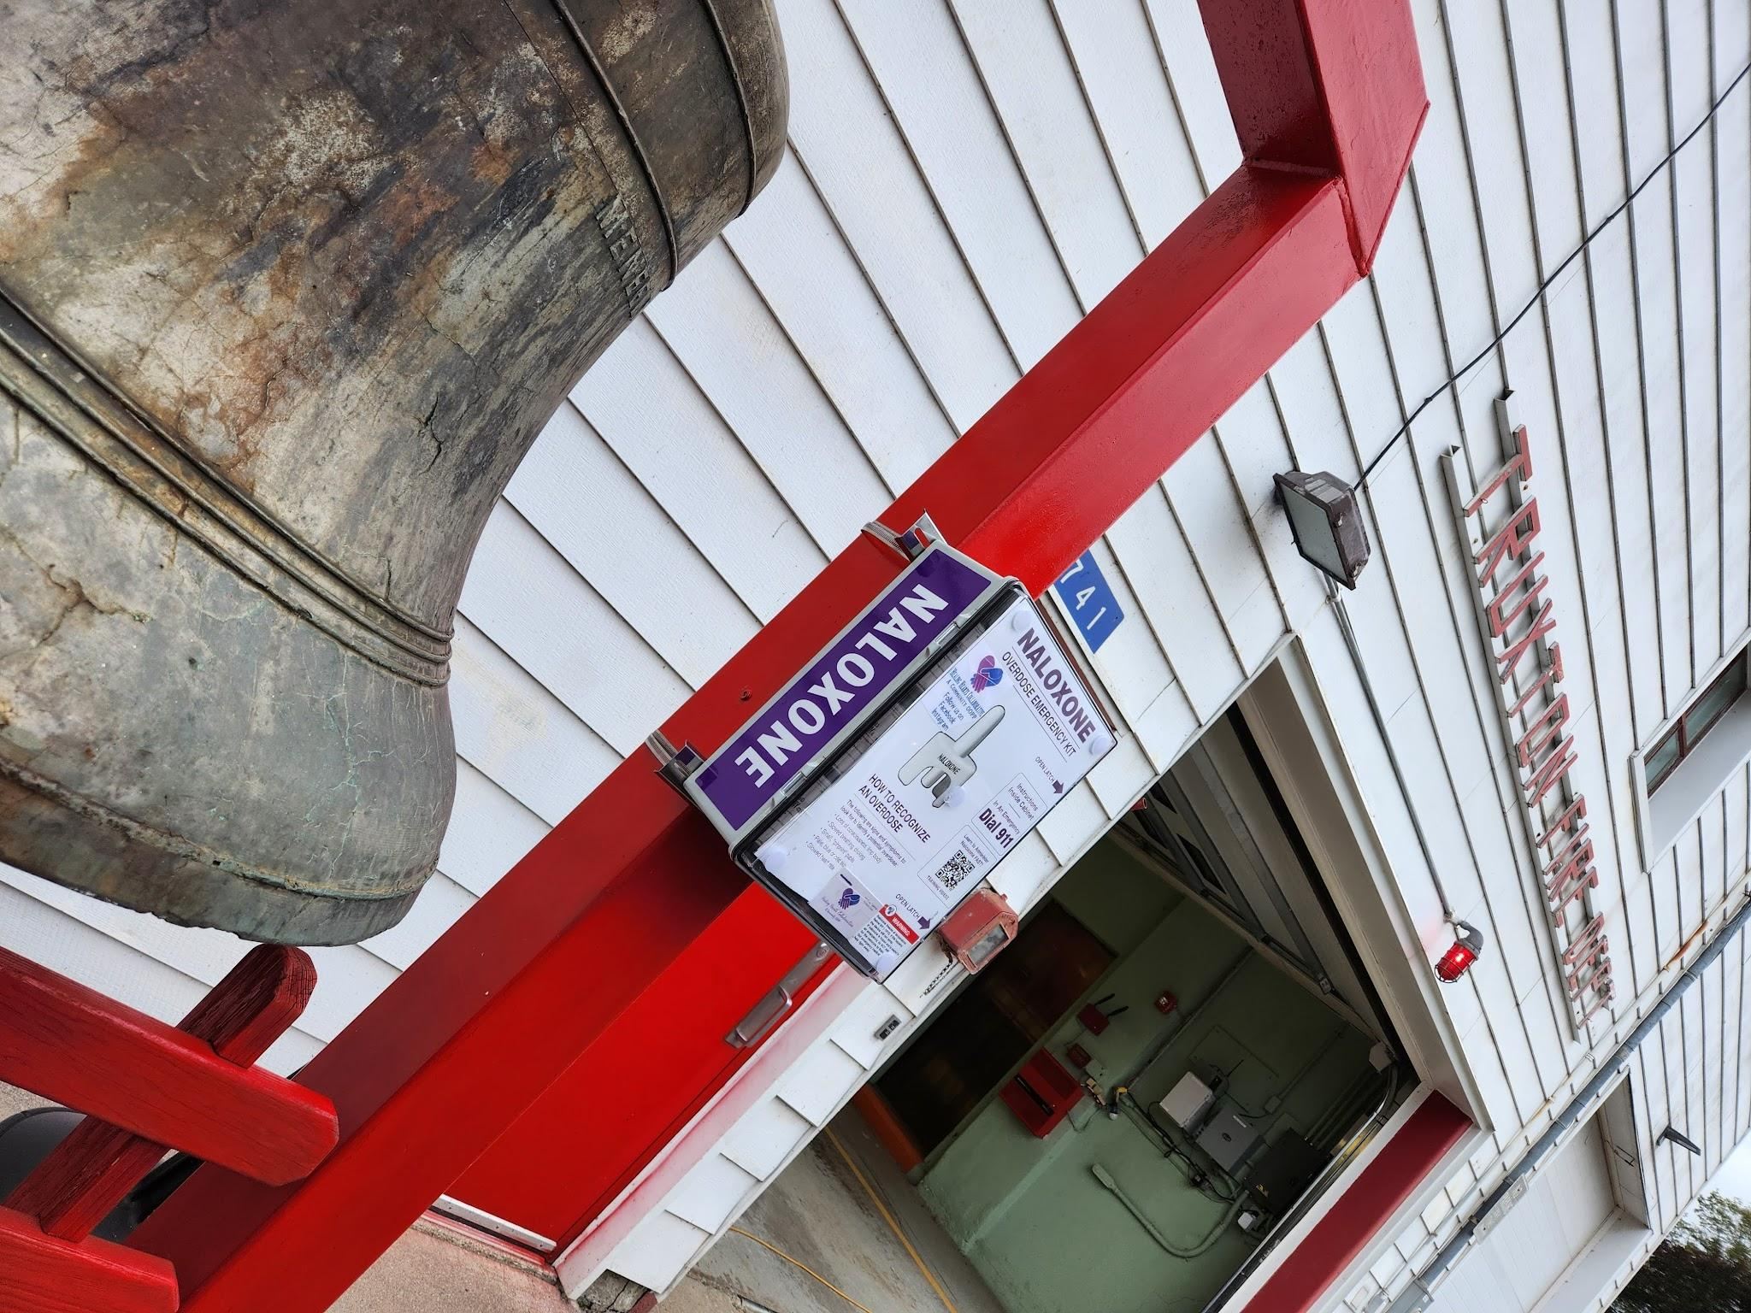
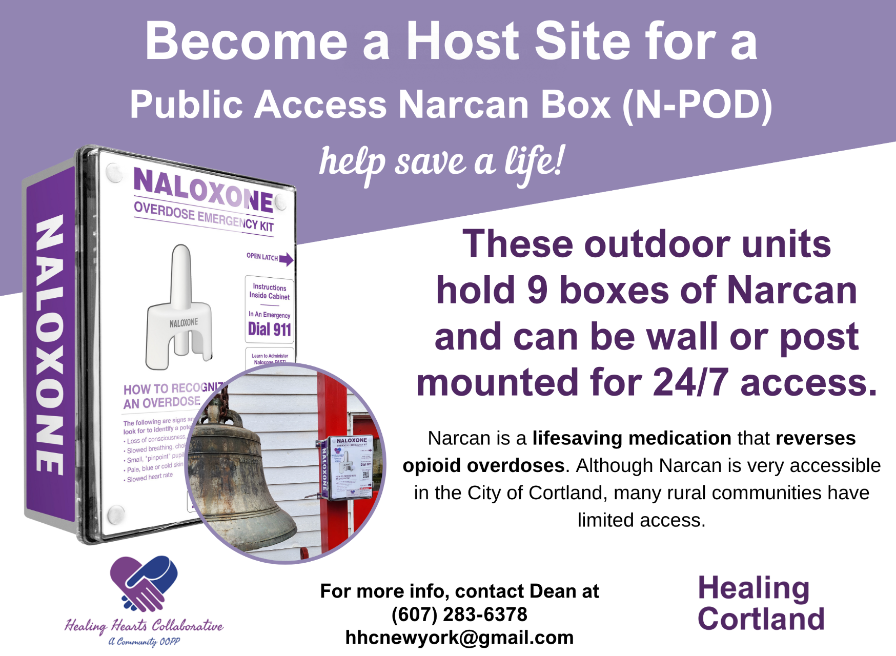
Staffing is important, but not in the ways we thought
Targeted outreach
Passive distribution is important for filling gaps (after hours, rural)
The role of volunteers & volunteer-based programs
Notes:
Sara

Slide 10
What did we learn?
MOUD Work
Stigma is a complicated barrier that requires consistent, diverse effort to address
It’s hard–but critical–to meaningfully include and engage people with lived experience
Notes:
Aster

Slide 11
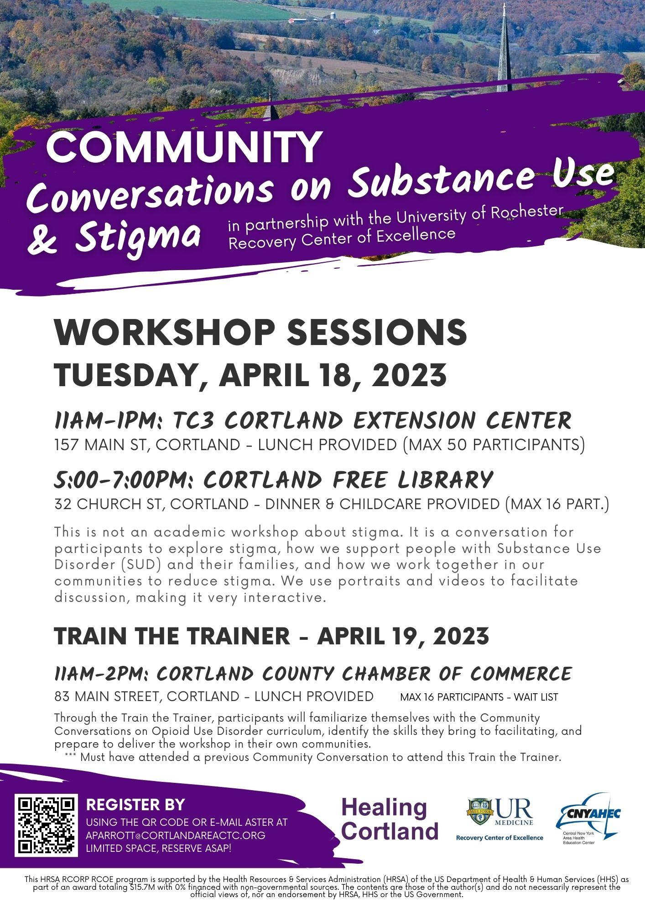
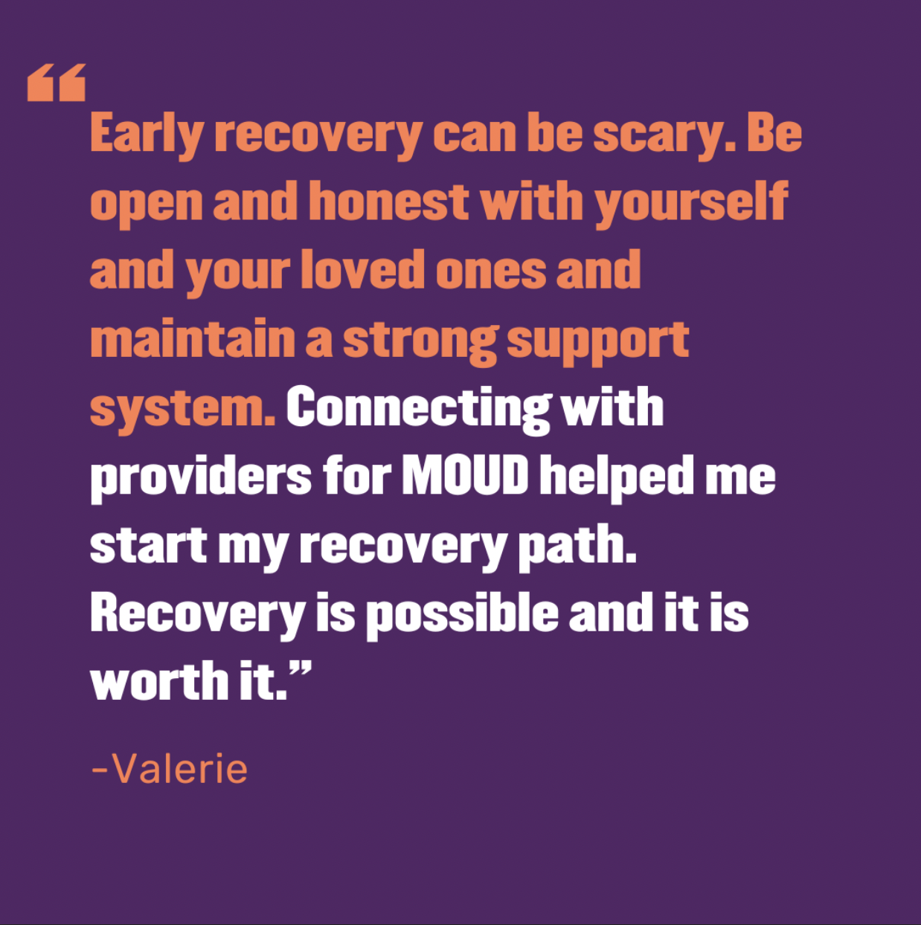
Stigma requires consistent, diverse effort
Communications Campaigns
Tailored
Multi-channel
Trainings and Conversations
Community Conversations
Individual Conversations
Repetition
Notes:
Aster

Slide 12
It’s hard–but critical–to meaningfully include and engage people with lived experience
Lived Experience Group
Challenges
Best practices
Support for and from the RCO
Input and Implementation
Notes:
Aster

Slide 13
What’s Next?
This important work will continue!
A lot of the work is being sustained by agencies & programs
The Opioid Task Force will move to Quarterly Meetings
Quarterly Narcan Meetings, next meeting in April
MOUD Workgroup > Provider Group
Working with SUD Subcommittee of the CSB
Working on collaborative grant applications with other agencies
Notes:
Sara

